Slide 1
Manual Tableau

Slide 2
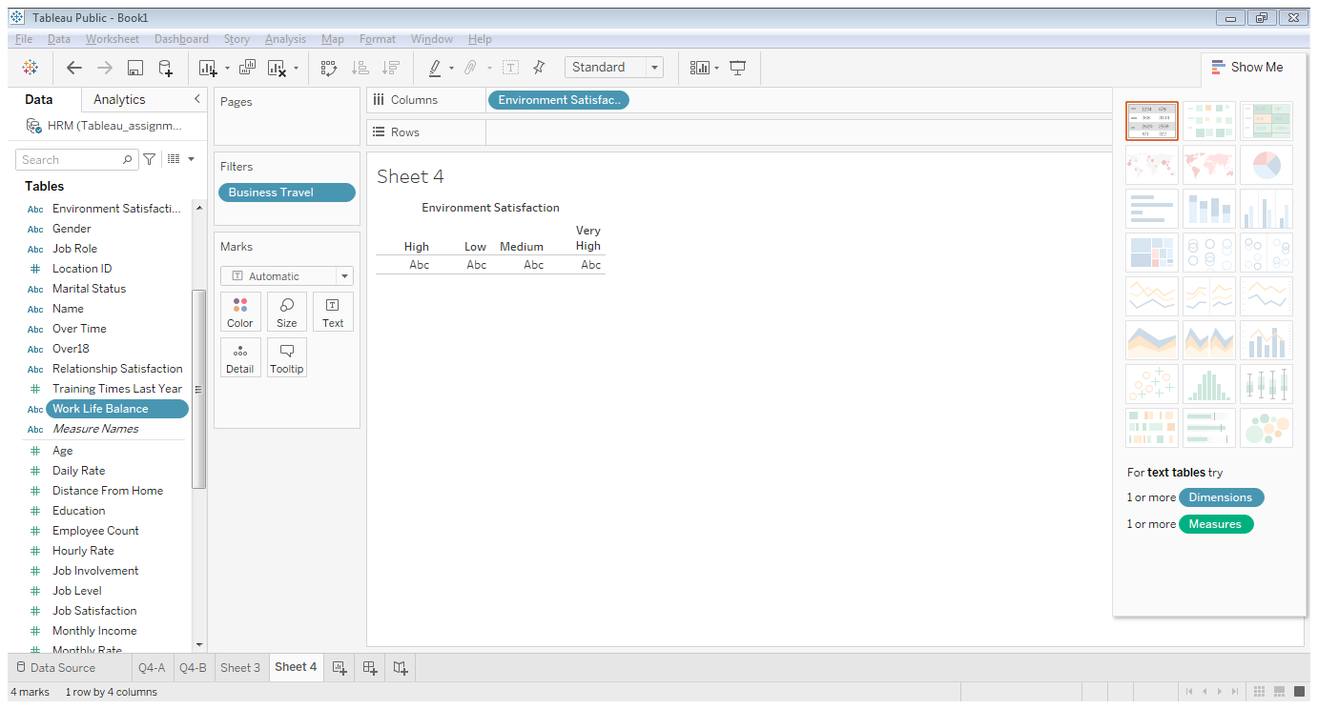
1- refresh data from sheets not from data source

Slide 3
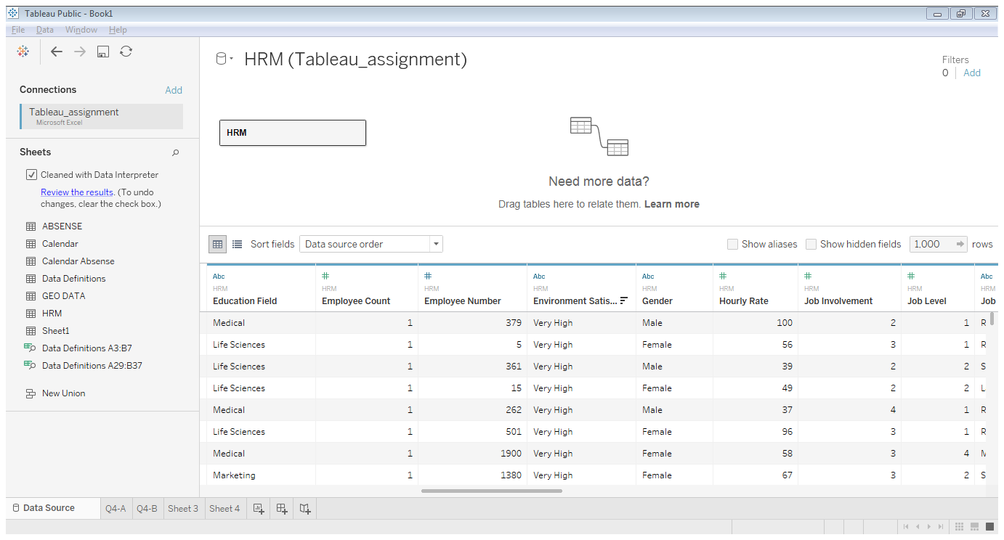
Click on the changed column and change the data type (from number to string and versus)

Slide 4
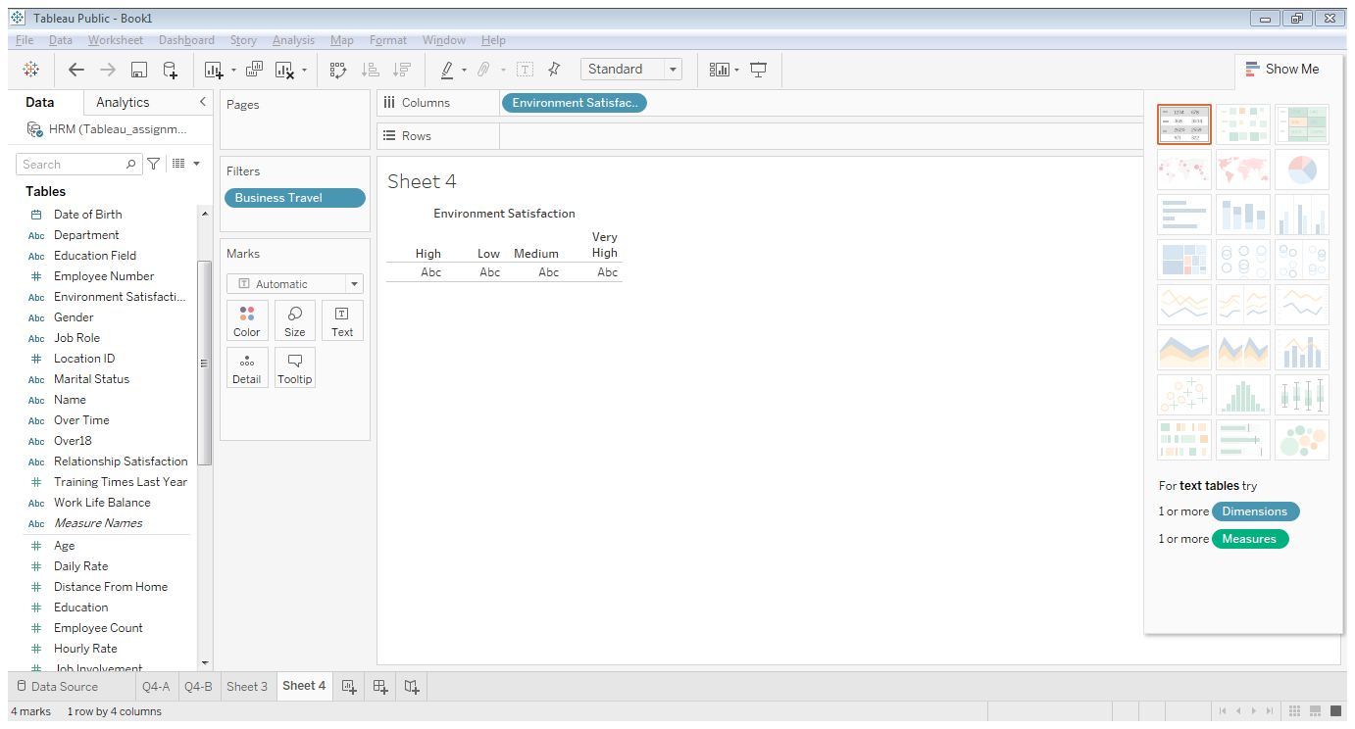
Move the changed column to the suitable list by right click on it and move

Slide 5
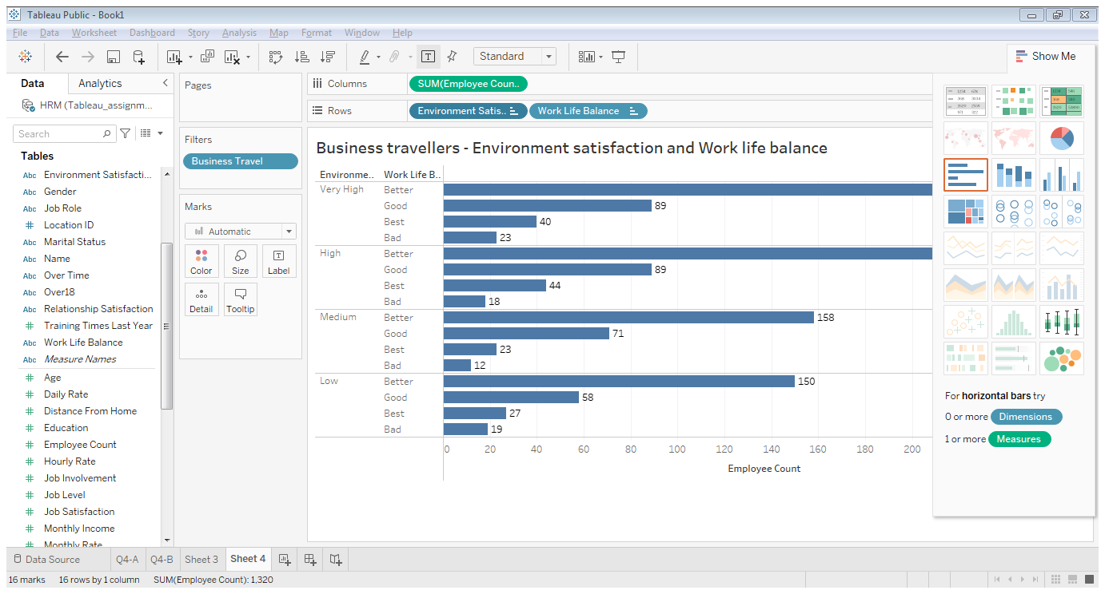
You can add External filter without adding it in the workspace

Slide 6
You can control on the filter working by right click on here

Slide 7
You can make manual or automated sort by Right Click on the wanted

Slide 8
e.dill11@nuigalway.ie
Password123.
when you open the link i sent , you can browse the interactive dashboard as in the video , and you can open it also on your tableau , is that you need ?
Tableau123!
https://drive.google.com/file/d/1EVX0XU5iFS-47C978J4Dr7ypbMJqpd2y/view

